Slide 1
An easy to use RPC framework
implemented by C++11/14
Yu Qi
qicosmos@163.com
Notes:
Today i want to introduce rest_rpc, a new approach to RPC libraries that shows off the power of modern C++.

Slide 2
Outline
1.Introduction to RPC
2.What is rest_rpc
3.Challenges of easy to use
4.Key technologies
6.What you can do with it

Slide 3
Introduction to RPC
Remote Procedure Calls
Call the function on the remote computer just like local function calls
Advantages:
Very easy to use, hide complications and details of network and framework
Greatly improve the efficiency of the development of interprocess communication
Notes:
Let’s look at the picture

Slide 4
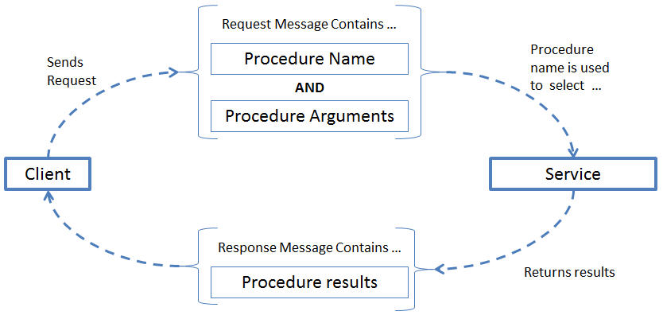
Introduction to RPC
Notes:
This picture shows some details of a complete RPC call process. Firstly, the client send a RPC request which contains procedure name and arguments to the server. Secondly the server parses the request and routes to the right procedure, and then executes the procedure, at last return the result to the client.
I think most people got the perceptual knowledge of RPC. Next i will introduce a concrete RPC library rest_rpc. I will discuss the challenges and technical details of how to implement an easy to use RPC library.

Slide 5
Outline
1.Introduction to RPC
2.What is rest_rpc
3.Challenges of easy to use
4.Key technologies
6.What you can do with it

Slide 6
What is rest_rpc
rest_rpc is an open source RPC library
link: https://github.com/topcpporg/rest_rpc
easy to use
rapid development
similar to rest api
Notes:
The compelling value proposition of the rest_rpc library is its focus on business logic and simplifying the calling code. Callers spend no time on networking details or data packing and unpacking.
Here are features of rest_rpc.
I’ll show you some examples about rest_rpc include client and server code.

Slide 7
What is rest_rpc
client code:
// Defines the call definition, check the grammar at compile time
TIMAX_DEFINE_PROTOCOL(add, int(int, int));
int main()
{
// Define synchronous client and msgpack serialization
rpc::sync_client<msgpack_codec> client;
//RPC request contains service name and arguments
auto endpoint = timax::rpc::get_tcp_endpoint("127.0.0.1", 9000);
auto result = client.call(endpoint, add, 1, 2);
assert(result == 3);
}
Notes:
Firstly you need define a micro contains service name, arguments types and return type. Secondly determine the serialization type, contains json, xml and msgpack format. finally call directly just like local call.
So you just need five lines code to finish the client RPC call. it’s very simple. rest_rpc of course support async call. Let’s look at the server code.
about the serialization I used a serialization engine iguana which is based on compile time reflection. I won’t talk about it this time, if you have interesting please look at my github.
about the micro I will talk about it later.

Slide 8
What is rest_rpc
server code:
//business logic
int add(int a, int b)
{
return a + b;
}
int main()
{
//define serialization type, support json, xml, msgpack
using server_t = rpc::server<rpc::msgpack_codec>;
server_t server{ port, pool_size, std::chrono::seconds{ 2 } };
server.register_handler("add", add); //register business handler
server.start();
}
Notes:
The server side code is also very simple, firstly define the serialization type, for example json, xml, msgpack formats, Secondly register business logic handler, and then you have provided a RPC service-add.
the register_handler interface is very flexible, support callable, you can register free function, lambda, member function, function object and so on.
From the example you can find both the client and the server need do very little things. the server just need register the business logic handler, and the client just need call with arguments.in a word the user just need focus on business, and needn’t care about anything else. So you can rapidly develop your application, this embodies the compelling value proposition of the rest_rpc , focus on business logic and simplifying the calling code.
Is it easy to use? You have to solve some problems to achieve easy to use goal. I’m glad to discuss how to archive the goal.

Slide 9
Outline
1.Introduction to RPC
2.What is rest_rpc
3.Challenges of easy to use
4.Key technologies
6.What you can do with it

Slide 10
Challenges
How to register callable of any signature
How to route the correct handler
How to simplify the call code
How to hide the details of serialization and networking
Notes:
The sever code is very simple, because you can easily register callable of any signature with a simple interface register_handler. you know there is no such a container which can hold different kinds of signatures in c++.
So how to register callable of any signature is the first challenge.
The second challenge is how to route the correct handler, because the request format from the client is binary data, you need to parse the string and finish a function call. so how to transform string arguments to real arguments?
The third challenge is simplify the call code, general, simple and powerful user interface is a challenge.
the last challenge is hide the details of serialization and networking, let users focus on the business logic.
ok let’s discuss the challenges now.

Slide 11
Challenges
grpc, sofa-pbrpc, pebble all three are based on pb
need define protocol file, complication and high learning cost
many restrictions, must inherit, no freedom
just only support one protocol
you should know many details of framework and network

Slide 12
Outline
1.Introduction to RPC
2.Problems of nowadays RPC framework
3.Challenges in developing a high performance and easy to use RPC framework
4.Key technologies
5.A little episode
6.What you can do with it

Slide 13
Challenges
No protocol file
No restrictions, just like local function
Just need focus on business
Support more protocol, even custom protocols
High performance

Slide 14
Challenges
rest_rpc resolve all the problems
https://github.com/topcpporg/rest_rpc

Slide 15
Outline
1.Introduction to RPC
2.Problems of nowadays RPC framework
3.Challenges in developing a high performance and easy to use RPC framework
4.Key technologies
5.A little episode
6.What you can do with it

Slide 16
Easy to use
Server code:
int add(int a, int b)
{
return a + b;
}
server_t server;
server.register_handler("add", add);
Client code:
sync_client client;
auto result = client.call(endpoint, add, 1, 2);
assert(result == 3);

Slide 17
Register all callable objects
server.register_handler("add", add);
server.register_handler("lambda_add", [](auto a, auto b){ return a+ b ; });
std::function<int(int,int> f = std::bind(&client::foo::add, &foo, std::placeholders::_1,
std::placeholders::_2);
server.register_handler("function_add", f);
server.register_handler("foo_add", timax::bind(&client::foo::add, &foo));
lambda
std::function
clean code
member function
bind

Slide 18
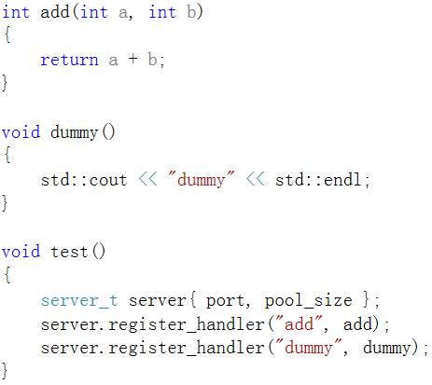
Register all callable objects
different kinds of functions
in one same container

Slide 19
Register all callable objects
C++ has no such a container
type erase
std::function?
boost.variant?
boost.any?
for network lost type information

Slide 20
Register all callable objects
A special type erase
template<typename Function>
struct invoker
{
static inline void apply(const Function& func, void* bl){}
};
carry function type information
can accept any callable
return type
parm type
referrence
const volatile
……
int
int&
int&&
const int&
……

Slide 21
Register all callable objects
template<typename Function>
void register_handler(std::string const & name, const Function& f)
{
using std::placeholders::_1;
std::map<std::string, std::function<void(void*)>> invokers;
this->invokers[name] = { std::bind(&invoker<Function>::apply, f, _1) };
}
can accept any function
wrapper function and real function are composed by std::bind
std::function erase function type
invoker<Function>::apply

Slide 22
Register all callable objects
template<typename Function>
struct invoker
{
static inline void apply(const Function& func, void* bl)
{
using tuple_type = typename function_traits<Function>::tuple_type;
const tuple_type* tp = static_cast<tuple_type*>(bl);
std::apply(func, *tp);
}
};
//from C++17
real function call

Slide 23
std::apply implement with C++11/14
template<typename F, typename ... Args>
void call(const F& f, const std::tuple<Args...>& tp)
{
call_helper(f, std::make_index_sequence<sizeof... (Args)>{}, tp);
}
template<typename F, size_t... I, typename ... Args>
static decltype(auto) call_helper(const F& f, const std::index_sequence<I...>&, const std::tuple<Args...>& tup)
{
return f(std::get<I>(tup)...);
}
More Details
https://github.com/qicosmos/cosmos/blob/master/modern_messagebus.hpp
http://www.cnblogs.com/qicosmos/p/4325949.html
<<In-Depth C++11>>

Slide 24
High performance
resolved
serialization
network

Slide 25
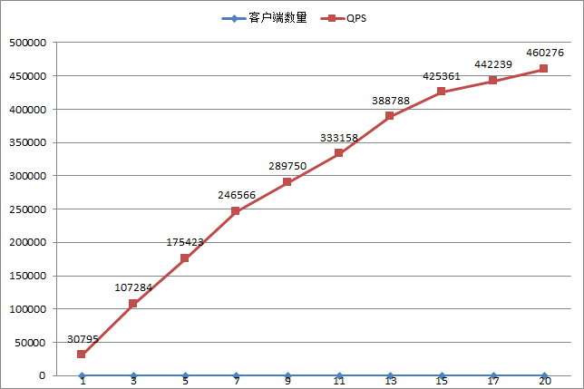
High performance
Performance of rest_rpc

Slide 26
High performance
High performance serialization library
json : Kapok(base on rapidjson)
apache msgpack
custom serialization

Slide 27
High performance
Kapok(https://github.com/qicosmos/Kapok)
struct person
{
std::vector<int> a;
int b;
META(a, b);
};
void test_serialization()
{
person p = { {1,2,3}, 4 };
Serializer sr;
sr.Serialize(p);
std::cout << sr.GetString() << std::endl;
}
support object, container, array, std::tuple,boost.optional, boost.variant….
very easy to use, no other work
void test_deserialization()
{
person p;
DeSerializer dr;
dr.Parse(sr.GetString());
dr.Deserialize(p);
}

Slide 28
High performance
Surpport many serialization protocols
Msgpack
Json
Boost.serialize
Custom
No need write any serialization code, rest_rpc framework do everything
Just need define serialization type
using server_t = server<msgpack_codec>;
using server_t = server<kapok_codec>;
using server_t = server<boost_codec>;
using server_t = server<customxx_codec>;

Slide 29
High performance
Network library
boost.asio: High performance, excellent asynchronous model, easy to use
Network IO and business should be asynchronous
Attention to sequence of asynchronous call chain
Zero-copy
Reduce the frequency of locking

Slide 30
Asynchronous IO
void do_accept()
{
acceptor_.async_accept(socket_, [this](boost::system::error_code ec)
{
if (!ec)
{
std::make_shared<session>(std::move(socket_))->start();
}
do_accept();
});
}
boost::asio::async_read
boost::asio::async_write
boost::asio::async_connect

Slide 31
Sequence of asynchronous call chain
void read()
{
auto self(this->shared_from_this());
boost::asio::async_read(socket_, boost::asio::buffer(data_, size_), [this, self](boost::system::error_code ec, std::size_t length)
{
if (!ec)
{
write(data_, length)
}
});
}

Slide 32
Sequence of asynchronous call chain
void write(char* data, size_t length)
{
auto self(this->shared_from_this());
boost::asio::async_write(socket_, boost::asio::buffer(data, length), [this, self](boost::system::error_code ec, std::size_t length)
{
if (!ec)
{
read();
}
});
}

Slide 33
Sequence of asynchronous call chain
call_back
is it good?

Slide 34
Sequence of asynchronous call chain
void read()
{
auto self(this->shared_from_this());
boost::asio::async_read(socket_, boost::asio::buffer(data_, size_), [this, self](boost::system::error_code ec, std::size_t length)
{
if (!ec)
{
read();
}
});
}

Slide 35
Sequence of asynchronous call chain
void ios_wrapper::write(connection_ptr& conn_ptr, context_ptr& context)
{
lock_t lock{ mutex_ };
if (!write_in_progress_)
{
write_in_progress_ = true;
lock.unlock();
write_progress_entry(conn_ptr, context);
}
else
{
delay_messages_.emplace_back(conn_ptr, context);
}
}
Performance improvements for 2-3 times

Slide 36
Zero-copy
auto get_message() const-> std::vector<boost::asio::const_buffer>
{
if (message.empty())
return{ boost::asio::buffer(&head, sizeof(head_t)) };
return{ boost::asio::buffer(&head, sizeof(head_t)), boost::asio::buffer(message) };
}
boost::asio::async_write(conn_ptr->socket(), ctx_ptr->get_message(), std::bind(
&ios_wrapper::handle_write, this, std::move(delay_messages), std::placeholders::_1));
avoid memory copy

Slide 37
Zero-copy
template <typename Message>
static auto make_message(head_t const& h, Message&& msg, post_func_t postf = nullptr)
{
return std::make_shared<context_t>(h, std::forward<Message>(msg), std::move(postf));
}
auto ctx = context_t::make_message(h, std::move(buffer), std::move(posf));
for (auto& alive_conn : alives)
{
auto self = this->shared_from_this();
ios_wrapper_.write(self, ctx);
}
avoid copy
share the same data

Slide 38
Reduce the frequency of locking
void ios_wrapper::write_progress()
{
lock_t lock{ mutex_ };
if (delay_messages_.empty())
{
write_in_progress_ = false;
return;
}
else
{
context_container_t delay_messages = std::move(delay_messages_);
lock.unlock();
write_progress(std::move(delay_messages));
}
}
Avoid multiple lock
move avoid copy
Minimize the lock scope

Slide 39
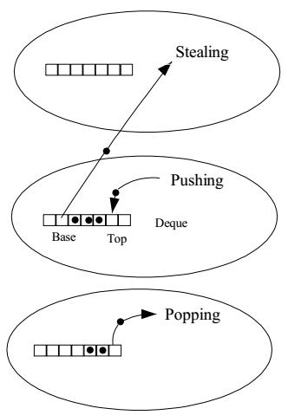
Task parallelization
Thread pool
Work steal

Slide 40
High performance
move, move capture
auto ctx = context_t::make_message(conn->head_, std::move(message),
[conn, r = std::move(result), &p]
{
p(conn, r);
});
avoid unnecessary copy

Slide 41
High performance
Lock-free : CAS operation using std::atomic
std::atomic<int> flag = 0;
std::thread thread1{ []{ flag.store(1); } }.detach();
std::thread thread2{ []{
int expected;
do expected = 1;
while(!flag.compare_exchange_weak(expected, 2));
} }.detach();
std::thread thread3{[]{
while(flag.load() != 2);
}};
thread3.join();

Slide 42
High performance
Lock-free : atomic operation with memory order
void reader_thread()
{
while(!data_ready.load(std::memory_order_acquire)) // operation C
std::this_thread::yield();
std::cout << data[0] << std::endl; // operation D
}
void writer_thread()
{
data.push_back(42); //operation A
data_ready.store(true, std::memory_order_release); // operation B
}
std::thread t1{ reader_thread }.detach();
std::thread t2{ writer_thread }.detach();

Slide 43
High performance
Thread local
The object is allocated when the thread begins and deallocated when the thread ends.
Each thread has its own instance of the object.
thread_local int flag = 0; // in global namspace
struct foo { thread_local static int flag = 0; }; // in class static data member
std::list<std::thread> threads;
for(int loop = 0; loop < 5; ++loop)
threads.emplace_back( []{
std::cout << ++flag << ++foo::flag << std::endl;} );
for(auto& thread : threads)
thread.join();
Eliminate memory fragmentation

Slide 44
Flexible
rest_rpc support RPC and sub/pub model
asycn_client.pub(endpoint, notify_topic, "test").on_ok([](auto r)
{
std::cout << r << std::endl;
}).on_error([](auto const& error)
{
std::cout << error.get_error_message() << std::endl;
});
asycn_client.sub(endpoint, notify_topic, [](auto r)
{
std::cout << r << std::endl;
},
[](auto const& error)
{
std::cout << error.get_error_message() << std::endl;
});

Slide 45
Flexible
RPC call and sub/pub can be mixed use any time and any where
RPC and sub/pub model have the common essence
rest_rpc supports request/response and sub/pub model
Very suitable for complex distributed system
HA
Binary star pattern
Bstar: https://github.com/topcpporg/bstar

Slide 46
Flexible
server.register_handler("foo_add", timax::bind(&client::foo::add, &foo));
timax::bind support object, smart pointer, raw pointer, placeholders
foo f; // normal object
auto f_ptr = std::make_shared<foo>(); // smart pointer
auto f_raw = new foo; // raw pointer
auto bind_1 = timax::bind(&client::foo::add, f, 1, 2);
auto bind_2 = timax::bind(&client::foo::add, f_ptr, 2, 3);
auto bind_3 = timax::bind(&client::foo::add, f_raw, 3, 5);
auto bind_5 = timax::bind(&client::foo::add, f_raw, _1, _2); // bind with placeholders
auto bind_6 = timax::bind(&client::foo::add, f); //bind without anything, clean code
Much more flexible and powerful than std::bind
Behind the flexibility is template meta program

Slide 47
Safe
No protocol file
How to check call error in compile time?
namespace client
{
TIMAX_DEFINE_PROTOCOL(add, int(int, int));
}
asycn_client.call(endpoint, client::add, 3, 5);
asycn_client.call(endpoint, client::add, 3, 5.0);
asycn_client.call(endpoint, client::add, "test", 5); //compile error, not matching

Slide 48
Template meta-programming
template <typename Func, typename ... Args>
struct is_arguments_match;
template <typename Ret, typename ... Args>
struct protocol<Ret(Args...)>
{
template <typename ... TArgs>
auto serialize_arguments(TArgs&& ... args)
{
static_assert(is_arguments_match<Ret(Args...), TArgs ...>::value, “blah blah blah”);
// your code
} };

Slide 49
Template meta-programming
template <typename Func, typename ... Args>
struct is_argument_match
{
private:
template <typename T>
static std::false_type test(...);
template <typename T, typename =
decltype(std::declval<T>()(std::declval<Args>()...))>
static std::true_type test(int);
using result_type = decltype(test<Func>(0));
public:
static constexpr bool value = result_type::value;
};
is matching?
Deduce the function return type,
Pretend to call,
SFINAE
decltype(std::declval<T>()(std::declval<Args>()...)
decltype(std::declval<T>()(std::declval<Args>()...)

Slide 50
Template meta-programming
timax::bind
object, smart pointer, raw pointer, placeholders
callable

Slide 51
Binding function and callable
template <typename F>
auto bind_function_callable(F&& f)
-> typename function_traits<F>::stl_function_type
{
return [func = std::forward<F>(f)](auto&& ... args)
{
return func(std::forward<decltype(args)>(args)...);
};
}
wrapper std::bind and return to std::function
funtion_traits: https://github.com/topcpporg/rest_rpc

Slide 52
Binding pmf with pointers
struct caller_is_a_pointer{};
template <typename F, typename Caller>
auto bind_impl_pmf(caller_is_a_pointer, F&& pmf, Caller&& caller)
-> typename function_traits<F>::stl_function_type
{
return [pmf, c = std::forward<Caller>(caller)](auto&& ... args)
{
return (c->*pmf)(std::forward<decltype(args)>(args)...);
};
}
NOTE: we support polymorphism

Slide 53
Binding pmf with object
struct caller_is_a_reference {};
template <typename F, typename Caller>
auto bind_impl_pmf(caller_is_a_reference, F&& pmf, Caller&& caller)
-> typename function_traits<F>::stl_function_type
{
return [pmf, c = std::forward<Caller>(caller)](auto&& ... args)
{
return (c.*pmf)(std::forward<decltype(args)>(args)...);
};
}

Slide 54
Binding pmf with smart pointers
struct caller_is_a_smart_pointer {};
template <typename F, typename Caller>
auto bind_impl_pmf(caller_is_a_smart_pointer, F&& pmf, Caller&& caller)
-> typename function_traits<F>::stl_function_type
{
return [pmf, c = std::forward<Caller>(caller)](auto&& ... args)
{
return (c.get()->*pmf)(std::forward<decltype(args)>(args)...);
};
}

Slide 55
Template meta-programming
voider ultility
template <typename ... Args>
struct voider
{
using type = void; };
template <typename ... Args>
using voider_t = typename voider<Args...>::type;
C++14 surpport void_t now
C++11 do not deduce Args… type

Slide 56
Template meta-programming
What can we do with voider?
Simplify the way of using SFINAE
Immune to reference and cv qualifiers
eg. a simple implemenntation of is_smart_pointer
template <typename T, typename = void>
struct is_smart_pointer : std::false_type {};
template <typename T>
struct is_smart_pointer<T,
voider_t<
decltype(std::declval<T>().operator ->()),
decltype(std::declval<T>().get()
>> : std::true_type {};
)
, decltype(std::declval<T>().reset())

Slide 57
Outline
1.Introduction to RPC
2.Problems of nowadays RPC framework
3.Challenges in developing a high performance and easy to use RPC framework
4.Key technologies
5.A little episode
6.What you can do with it

Slide 58
Episode
boost::placehodler::_1 ... are in the gloable namespace
There are several ways to solve this
1. Add a macro BOOST_BIND_NO_PLACEHOLDERS ahead
2. Make std::bind compatible with boost::placerholers
We choose the second.
namespace std
{
template <int Size>
struct is_placeholder<boost::arg<Size>>
: public std::integral_constant<int, Size>
{
}; }

Slide 59
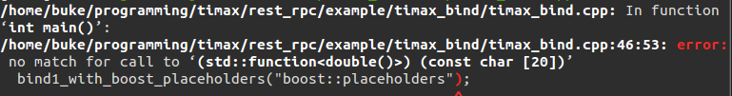
Episode
A bug from gcc
we got a compile-time error from the code below
timax::bind(add, 1, _1); // with boost placeholder
boost::placeholders::_1 is a const reference of boost::arg<1> object, and we guess that gcc is not doing well with const reference to placeholder
Solution:
use TMP to return a new object when forwarding boost placeholder

Slide 60
Episode
template <typename T>
struct forward {
template <typename T1>
static decltype(auto) apply(T1&& t1) noexcept {
return std::forward<T>(t1);
}
};
template <int Size>
struct forward<boost::arg<Size> const&> {
template <typename T1>
static auto apply(T1&& t1) noexcept {
return t1;
}
};
remove const reference

Slide 61
Outline
1.Introduction to RPC
2.Problems of nowadays RPC framework
3.Challenges in developing a high performance and easy to use RPC framework
4.Key technologies
5.A little episode
6.What you can do with it

Slide 62
rest_rpc can be used to do
Interprocess communication
Distribute system
HA(binary star, raft)
Service discovery
Message queue
Distribute compute
Distribute storage

Slide 63
Links
https://github.com/topcpporg/rest_rpc
http://purecpp.org/
Contact me: qicosmos@163.com

Slide 64
Questions?

